Slide 1
SoarTech Update 2021
Michael van Lent, Ph.D.
CEO, President

Slide 2
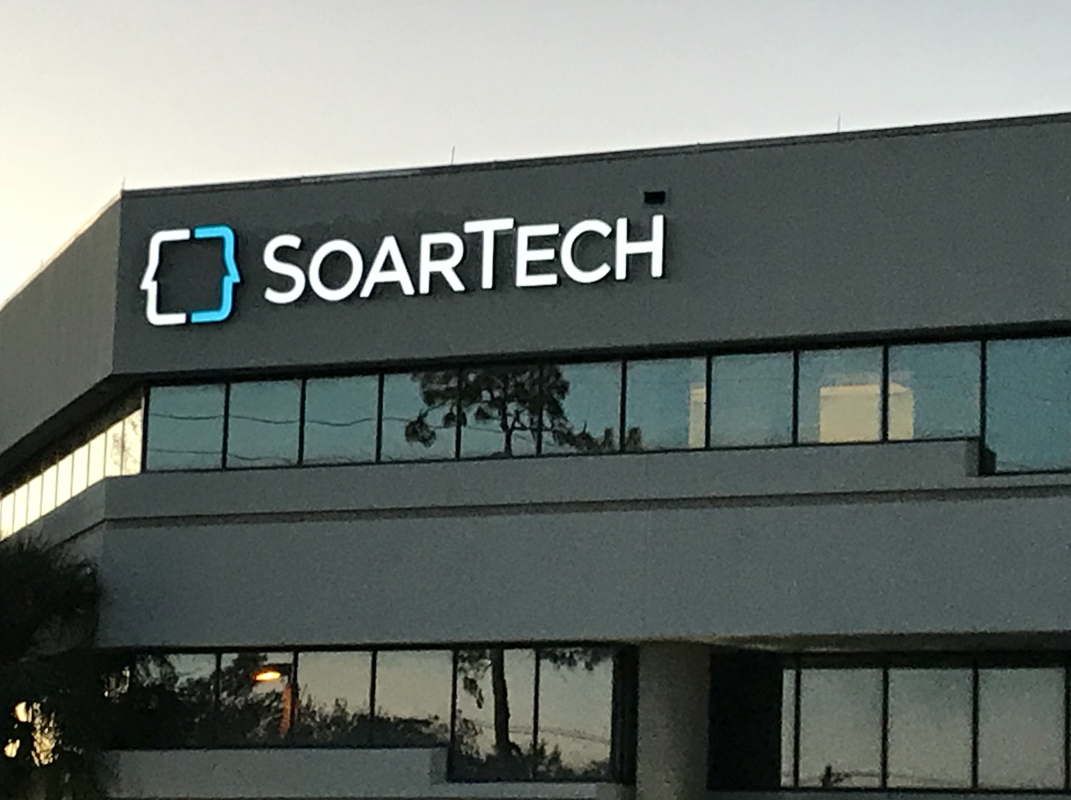
Quick Introduction to SoarTech
Spun off of the U of Michigan Soar group in 1998
~120 employees
26+ with PhDs, 32+ with Masters
2 offices (Ann Arbor; Orlando)
Plus remote employees in 6 states
~75 active research contracts
DARPA, Navy, Army, Air Force
100% of ownership “in the family”
Three founders still closely connected
Current and former employees
6 person Board of Directors (3 employees)
SoarTech Mission: We develop human-centered artificial intelligence solutions for the military’s toughest problems

Slide 3
Military’s Toughest Problems
High Stakes
Gaps in system performance could be costly (lives, mission outcomes, money)
AI must be trustworthy, trustable, trusted
AI must be capable of supporting verification, validation & accreditation (VV&A)
Human In The Loop
ROEs and larger legal, moral and ethical regulations require humans in the decision loop
AI must support natural, multi-modal human-machine interfaces
AI must be transparent, interpretable, explainable
AI must be able to communicating its intent and understand the human’s intent
Data Sparse
Military operations are infrequent and expensive, making training data hard to obtain
AI must learn from multiple knowledge sources (e.g. multi-source learning, interactive task learning)
AI must integrate with simulations to learn from synthetic datasets

Slide 4
How to achieve our mission?
SoarTech Mission: We develop human-centered artificial intelligence solutions for the military’s toughest problems
Build a great solutions pipeline, not just one great solution
The military has many tough problems, but with common characteristics
No single AI technique is the right solution for all problems
SoarTech is a pipeline for human-centered AI solutions from research to warfighter impact
Develop a toolbox of AI techniques, not just one single technique
Techniques carefully curated in response to the common characteristics
The military’s toughest problems are high-stakes, human-in-the-loop and data-sparse
SoarTech has an “AI toolbox” philosophy
Lead the charge to leverage cognitively-inspired AI techniques
Deep reinforcement learning is a powerful technique, but not a “silver bullet”
Cognitively-inspired AI techniques excel on high-stakes, human-in-the-loop, data-sparse problems
SoarTech is the industry leader in “AI, fast and slow”

Slide 5
SoarTech’s Focus

Slide 6
SoarTech’s AI Toolbox
Cognitively-inspired Systems
Soar Cognitive Architecture
Episodic Memory
Semantic Memory
Spatial Visualization
Interactive Task Learning
Abductive Reasoning
Reinforcement Learning
Machine Learning
Deep/Reinforcement Learning
Generative Adversarial Networks
Quantum Adversarial Networks
Multi-modal Interaction
Natural Language & Dialogue
Speech Recognition
Speech Generation
Gesture Recognition
Swarm Intelligence
Adaptive User Interfaces
Perception/Image Recognition
Explainable AI
Human Factors
Game Theory

Slide 7
Project Example: ACE-TRUST
Trustworthy
Offline trustworthiness assessment creates a trustworthiness envelope
Trustworthiness assessment has limited visibility into the autonomy
Trustable
Augmented reality display in the cockpit
Displaying autonomy’s situational awareness and intended actions
Trusted
Measure trust via physiology, cognitive load, eye tracking and behavior
Continuous online trust calibrator

Slide 8
Nuggets and Coal
Nuggets of Gold
Strong DoD-wide focus on using AI to solve tough problems
More opportunities than we have time to pursue
The staff carefully developed and the reputation carefully earned over 23 years of providing AI to the DoD is a differentiator
SoarTech weathered COVID amazingly well
Chunks of Coal
Waiting for the DoD (and the world) to wake up to the limitations of deep learning
Attracting and retaining top-notch technical talent is our most critical challenge
With growth and new opportunities comes change. Change is hard.
With such a wealth of opportunities comes many distractions. Focus is hard.

